Slide 1
DBMS Project 2: End-to-End Weather Database System
Team Name: Team RRPB Members: Ravi Kakadia, Rohan Tilwani, Pavan Kodati, Bhavanand Jupalli

Slide 2
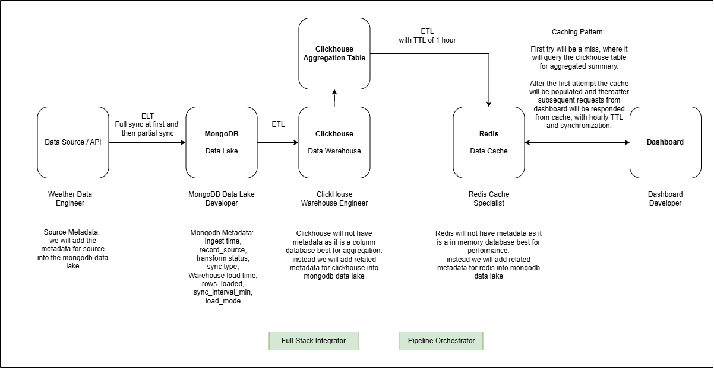
Final Pipeline Diagram

Slide 3
What went well during development?
Successful integration between multiple technologies: MongoDB was able to store raw and enriched weather data, and ClickHouse handled analytical workloads efficiently.
Incremental load pipeline was implemented effectively: Only new data was processed instead of reloading everything. This reduced system overhead and aligned well with warehouse best practices.
Weather data transformation pipeline was stable: Raw API output was successfully normalized into a clean row format structure. Important fields such as temperature, rainfall, humidity, and soil parameters were mapped into consistent schemas.
Data warehouse inserts performed quickly: ClickHouse handled bulk inserts efficiently, even with large batches.
Metadata enrichment improved observability and traceability

Slide 4
What did not go well or caused challenges
Open Meteo API had many attributes but because of lack of field expert choosing the right one was a challenge.
We are not running our server the whole time hence there will be gaps in sync.
Initial schema design considerations: Choosing appropriate data types (Float32, DateTime, MergeTree ordering) required additional research to avoid performance bottlenecks during warehouse ingestion.
Handling time-format inconsistencies: The Open-Meteo API returned timestamps without seconds (2024-11-20T17:00), causing parsing failures in ClickHouse until formatting logic was added.
Decide the attributes of the aggregation table to present in the dashboard.

Slide 5
What you would do differently next time
Implement a proper incremental scheduling system early: Instead of running manual or single-run scripts, introducing cron-based scheduling from the beginning would provide automation and better long-term reliability.
Introduce a structured logging & alerting system: A centralized log file or monitoring tool would make failures more visible and easier to diagnose without scanning console output.
Add retry logic before writing into warehouse: Failed inserts could be stored temporarily in a retry queue or DLQ (Dead Letter Queue), ensuring no data loss and improving fault tolerance.
We would add more validation rules and unit tests for the transformations so that bad data is caught earlier before it reaches ClickHouse, Redis, or the dashboard.

Slide 6
Thank you!

